Slide 1




Implementing Causal Machine Learning in Online Workshop 4: Data for the hands-on-project & useful descriptive statistics
August / September / October 2024
Michael Lechner Professor of Econometrics | University of St. Gallen | Switzerland

Slide 2
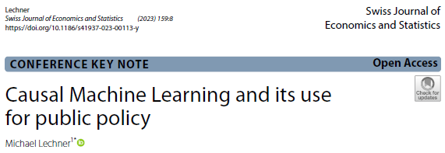
The workshop series | 1
4 online workshops/lectures + 1 week of workshops in Astana
Goal of the Workshop series
Use Causal Machine Learning for UNICEF / Government programme evaluation (& improvement)
CML: Machine learning algorithms adapted to analysing causal questions
Goal of online workshops
Lay the necessary foundations for understanding specific CML methods
Introduction to causal analysis (workshops 1 & 2)
Introduction to machine learning / statistical learning (workshop 3)
Introduction of data to be used in Astana in hands-on sessions & descriptive tools useful for causal analysis (workshop 4)
Michael Lechner

Slide 3
The workshop series | 2
4 online workshops
August 27, 14³⁰-16³⁰: Correlation & causation
September 3, 14³⁰-16³⁰: Available identification strategies & classical estimation
September 10, 14³⁰-16³⁰: Machine Learning
September 11, 14³⁰-15³⁰: The data for the Astana workshop & useful descriptive statistics

Slide 4
The workshop series | 3
The Astana Workshop September 30 to October 4, 2024 (10-13, 14:30-17:30)
Monday
Morning: Identification with experiments & selection on observables
Afternoon: Discussion of potential programmes to be evaluated
Tuesday: Causal Machine Learning (theory) (ends at 16:00)
Wednesday
Morning: 2 empirical examples
Afternoon: The mcf package – how to use it & how to interpret the results
Thursday: Doing an empirical study in groups with the data introduced in online workshop 4
Friday: Discussion of programmes to be evaluated continued (core team only)

Slide 5
Quick introduction
Participants (only Astana Workshop)
Professional background?
Knowledge in the estimation of causal effects, machine learning, Python?
Myself
Professor of Econometrics at the University of St. Gallen
Co-head of The Swiss Institute for Empirical Economic Research at the University of St. Gallen
Empirical Economic Research | SEW-HSG | University of St.Gallen (unisg.ch) www.michael-lechner.eu
Research interest in Causal Machine Learning, AI, programme evaluation, …

Slide 6
Plan for today’s workshop
The data for the Astana workshop & useful descriptive statistics
Information on the data provided
Basic descriptive statistics
Selectivity in the data
Common support
Your take-home task
Do descriptive analysis of your region of choice
Estimate the programme effects with OLS on the common support

Slide 7


Slide 8

1 | Introduction
2 | Information on the data provided
3 | Basic descriptive statistics
4 | Selectivity in the data
5 | Common support
6 | Do-until-workshop-in-Astana task
7 | Conclusions & outlook

Slide 9
Data & context description
Evaluate an Active Labour Market Policy with 4 different programmes of country XXX
2 different training programmes
2 different employment programmes
Non-participant
The file study_description.pdf provides …
Information on programmes, selection-into-the programmes & other institutional details
This information should be sufficient to decide on a credible research design (i.e., identifying assumption)
Code book for the data

Slide 10
Data
Data comes from 5 different regions of that country
Central.csv, East.csv, North.csv, South.csv, Southwest.csv, West.csv
These data files may contain missing values
Two additional (somewhat cleaned) data sets are available for test purposes
Large_testdata_noNaN.csv (N=100’000)
Small_testdata_noNaN.csv (N=4’000)
All data files
contain the same variables
are comma separated with variable names in the first row
Python: Easy way to read this data is putting the data into a Pandas DataFrame
E.g., data_df = pandas.read_csv(file_name)
The subsequent statistics are based on Large_testdata_noNaN.csv

Slide 12
1 | Introduction
2 | Information on the data provided
3 | Basic descriptive statistics
4 | Selectivity in the data
5 | Common support
6 | Do-until-workshop-in-Astana task
7 | Conclusions & outlook

Slide 13
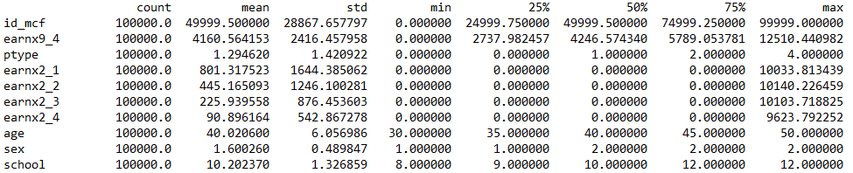
Standard descriptive statistics
Min, max, mean, median, # of NaN’s
Purpose (smell tests)
Identify inconsistencies with the data codebook ➔ SEX cannot have a minimum of 1!
Check credibility of variables
Example: Is the mean of earnings plausible?
Check if it is plausible that data is representative for a meaningful population or highly selective
…

Slide 14
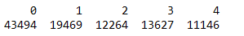
Descriptive statistics by treatment status | 1
Check if all treatments are large enough to be formally evaluated
Check unadjusted outcome difference (causal effect incl. selection)
This would be the treatment effect if there is no selection bias
Either programme 4 is highly selective, or there is a huge negative (!) programme effect for P4

Slide 16
1 | Introduction
2 | Information on the data provided
3 | Basic descriptive statistics
4 | Selectivity in the data
5 | Common support
6 | Do-until-workshop-in-Astana task
7 | Conclusions & outlook

Slide 17
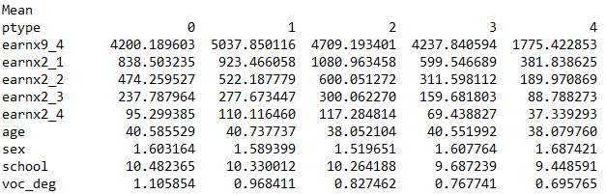
Descriptive statistics by treatment status | 2
Get descriptive impression about possible variables leading to selection effects
Pre-programme earnings & schooling for participants in P4 are much lower
Most likely at least partly responsible for negative unadjusted effect (seen in previous slide)

Slide 18
Balancing tests | 1
Balancing tests are a more formal way to check if some variables have an unequal distribution between the treatments
Pairwise comparisons between programmes
Two common approaches
Formal two sample t-test for mean differences
Rejects (almost) always if sample is large enough, even if differences are too small to matter
Standardized difference
Independent of sample size
Values > 10/20 are seen as indication or stronger selection

Slide 19
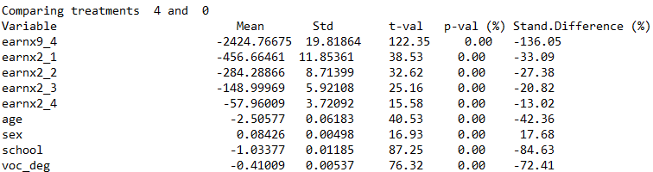
Balancing tests | 2
As example, let’s look at P4 again
Clear indication of strong selectivity!

Slide 20
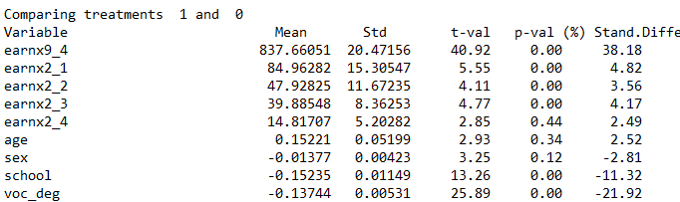
Selectivity for P4 much stronger than for, e.g., P1

Slide 22
1 | Introduction
2 | Information on the data provided
3 | Basic descriptive statistics
4 | Selectivity in the data
5 | Common support
6 | Do-until-workshop-in-Astana task
7 | Conclusions & outlook

Slide 23
Intro
The common support conditions means in this data that every unit in the data must be able to end up in all 5 possible states
If the common support condition is violated, many causal evaluation methods will not work

Slide 24
How to check for common support violation | 1
Descriptive statistics by treatment state
Are there any features that do not appear in certain treatments? → check means by treatment
Not obvious from the descriptive analysis so far
But: Consider more variables in descriptive analysis
But: Recode categorial variables as dummies to make detection easier

Slide 25
How to check for common support violation | 2
Check formal identification condition (propensity score)
However, even if this is fulfilled, it might be in the data there are no comparison observations that have similar propensity scores in the different treatment groups

Slide 26
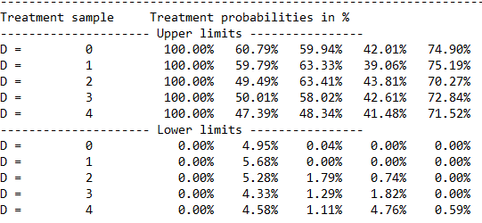
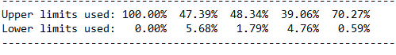
How to check for common support violation | 3
Rule
Largest acceptable upper value: Smallest maximum in any treatment sample
Smallest acceptable lower value: Largest minimum in any treatment sample

Slide 27
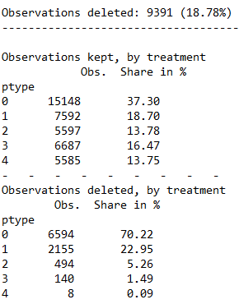
Remedies
Delete observation that are off-support

Slide 28
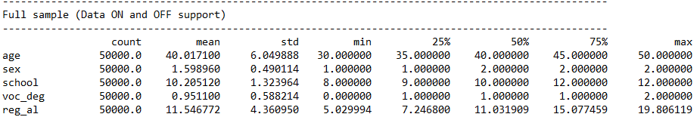
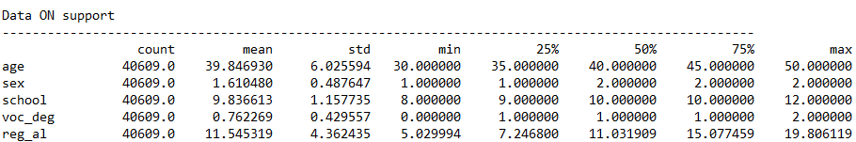
Implications
Has the population changed in an important way?

Slide 29
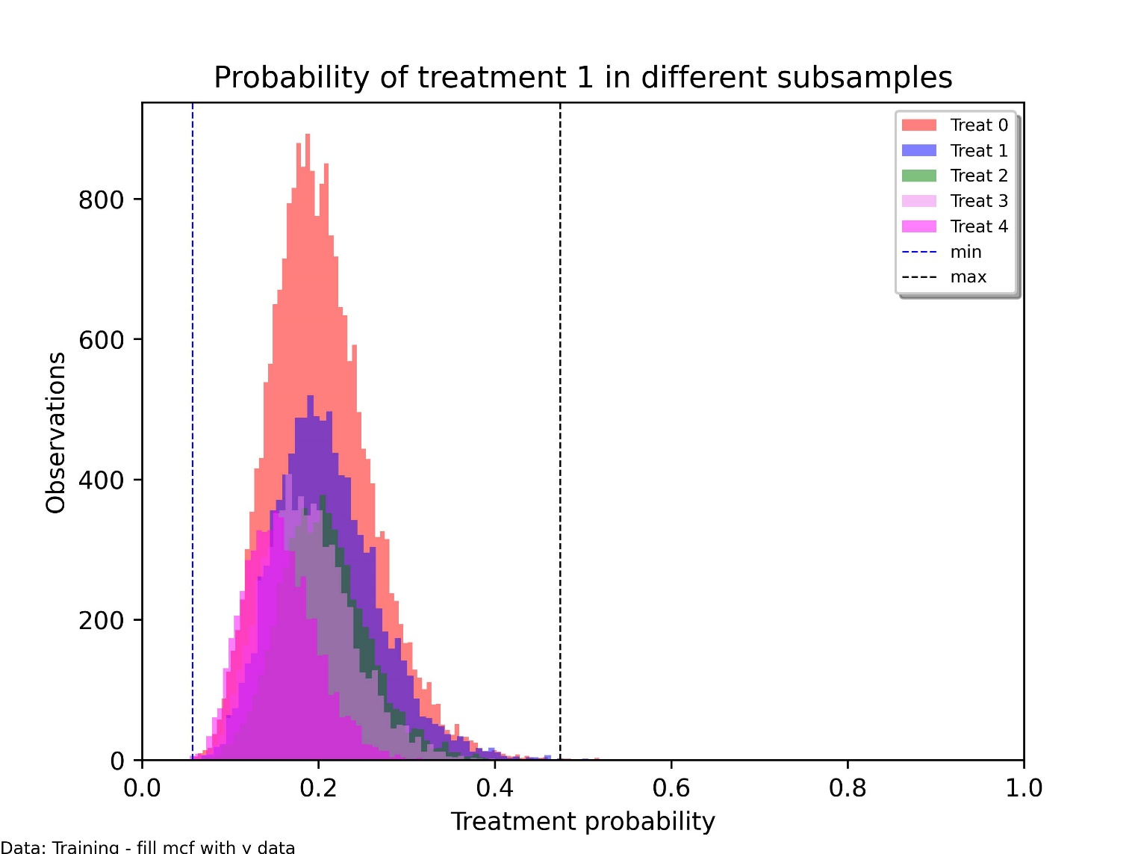
Visualisations | P1

Slide 30
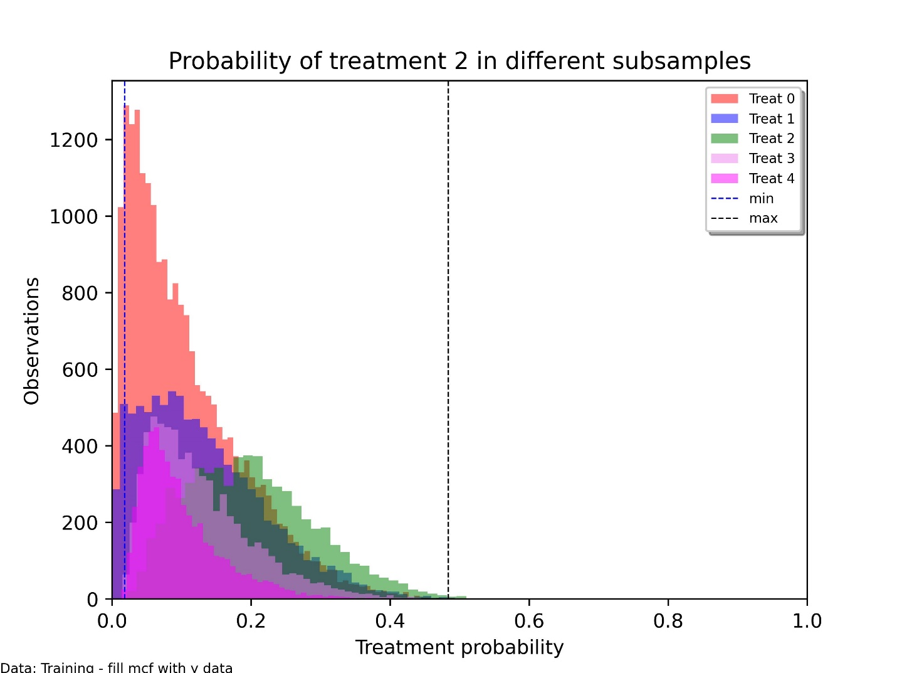
Visualisations | P2

Slide 31
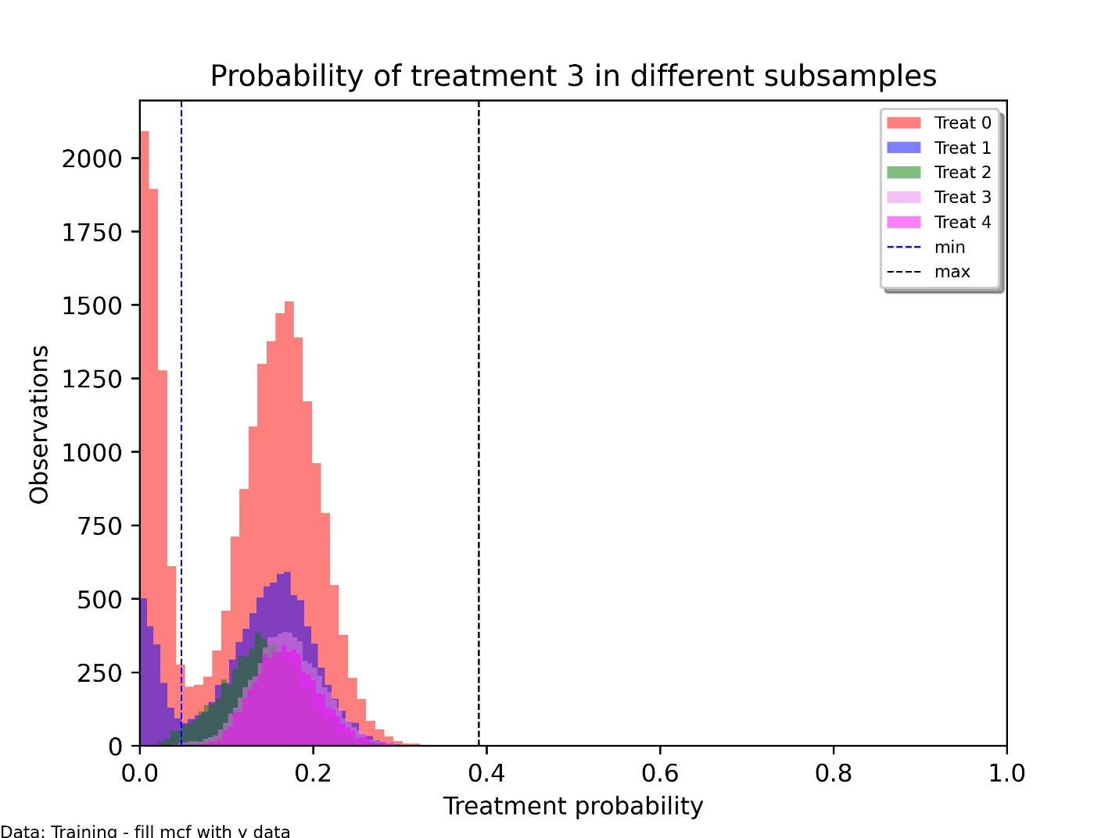
Visualisations | P3

Slide 32
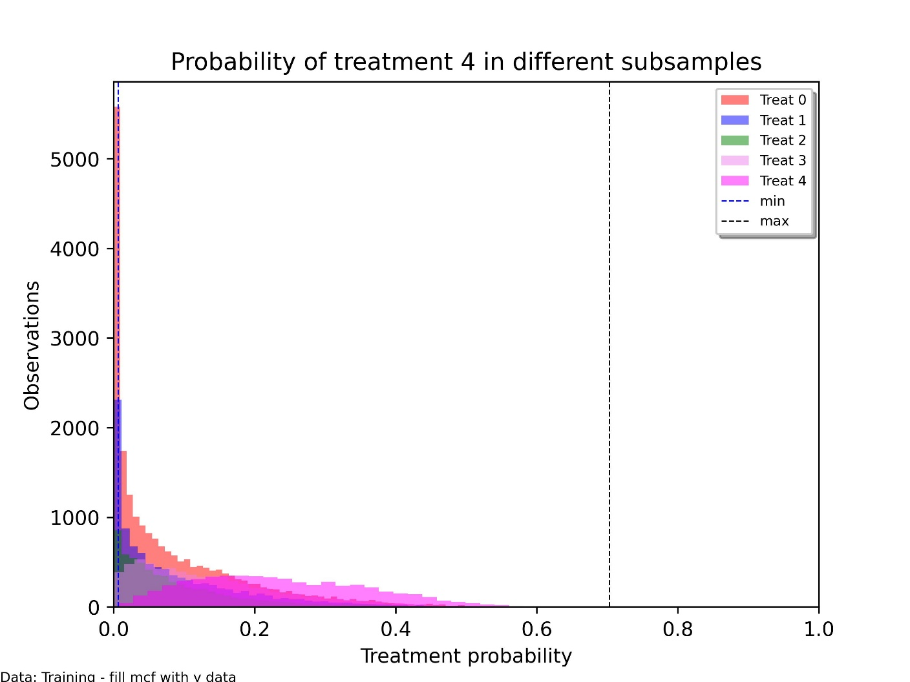
Visualisations | P4

Slide 34
1 | Introduction
2 | Information on the data provided
3 | Basic descriptive statistics
4 | Selectivity in the data
5 | Common support
6 | Do-until-workshop-in-Astana task
7 | Conclusions & outlook

Slide 35
Tasks
Provide the descriptive statistics discussed in this lecture for one of the regions in country XXX
Analyse the common support
Provide a regression (OLS) based estimation of the average causal effect of all 4 programmes compared to non-participation
Use the common support as data
Specify the treatment with 4 indicator variables, one for each programme

Slide 36
Practical hints | 1
You may choose the data from region you prefer
All data files have the same structure
*****testdata_noNaN.csv have no missing values, while the other files have missing values
It may be an efficient procedure to develop the code & run it on the smallest data set
Small_testdata_noNaN.csv
Once everything is running, apply your programme to your region of choice

Slide 37
Practical hints | 2
There are two possible strategies to solve the take-home
Compute the statistics with your software / package of choice
All statistical packages should be able to do this (perhaps with the exception of the standardized difference)
Use the mcf module in Python for the descriptive statistics
All statistics discussed are implemented in the mcf Python module
If you will participate in the Astana hands-on (Thursday), then this is the efficient strategy
pip install mcf (from PyPI)
Follow advice about installation on mcf homepage (Modified Causal Forests — mcf 0.6.0 documentation (mcfpy.github.io))

Slide 39

1 | Introduction
2 | Information on the data provided
3 | Selectivity in the data
4 | Comprehensive CML estimators
5 | Common support
6 | Do-until-workshop-Astana task
7 | Conclusions & outlook

Slide 40
Take-away
A suitable descriptive analysis is an important 1st step in any causal analysis
Check if data is ok (variables, population)
Analyse common support

Slide 42
Next: The Astana workshop – see you there!
AND if you are not familiar with Python (& will participate in the hands-on sessions in Astana), attend the Python courses recommended by Alibi
Michael Lechner
Swiss Institute for Empirical Economic Research (SEW) University of St. Gallen | Switzerland

